Slide 1
DML Triggers and Indexing
Presented By:​​
Shikshya Maharjan​​
Aarya Tuladhar​​
Luniva Shilpakar

Slide 2
What is trigger?
It is the stored procedures that executes (fires) specified set of statement in response to certain database events.

Slide 3
DML Triggers
DML Triggers are fired automatically in response to the DML events like
(INSERT,UPDATE,DELETE).
DML triggers again can be divided into 2 types:
AFTER Tiggers
INSTEAD OF Triggers

Slide 4
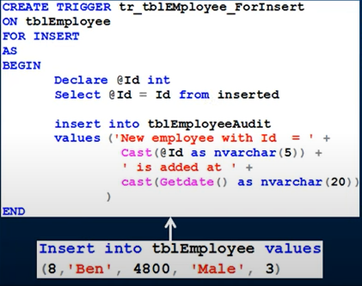
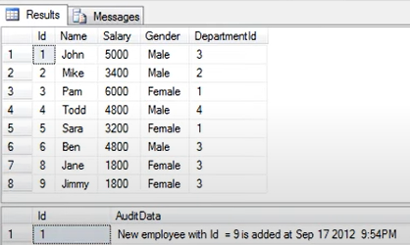
AFTER Triggers
Execute after the DML operation is completed.
SELECT * from tblemployee

Slide 5
INSTEAD OF Triggers
It replaces the specified set of SQL statement(INSERT,UPDATE,DELETE)
Mostly used on views, where direct modification is not allowed
Tells what to do instead of original data.

Slide 6
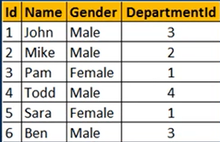
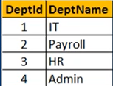
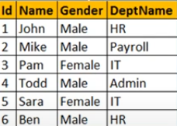

Slide 7
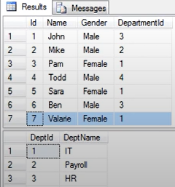
Syntax
CREATE TRIGGER tr_vwEmployee_InsteadofInsert insert into tblemployee(id,name….)
on vwEmployeedetails select id,name,gender,@depid
INSTEAD OF INSERT from inserted
AS END
BEGIN
DECLARE @Depid int
Select @Deptid=Deptid
From tbldeperatment
Join inserted
On inserted.depname=tbldepartment.deptname
END

Slide 8
How Triggering Works,
Where and Why Triggering Works,
Pros and Cons.

Slide 9
How Triggering Works
1. A specific event happens
Example: A row is inserted, updated, or deleted in a table.
2. The trigger is activated
The database sees the event and runs the trigger code automatically.
3. The trigger performs its action
It can check data, stop invalid changes, insert logs, or update other tables, depending on what it’s told to do.

Slide 10
Where and Why Triggers Are Used
1. Auditing (Tracking Changes)
Where used?
-In companies where it's important to know who changed what and when (banks, hospitals, school systems).
Why?
-Triggers help log every change to a table (e.g., when a student's grade is updated or when salary is changed).

Slide 11
Where and Why Triggers Are Used
Enforcing Rules
Where used?
-In company payroll systems or HR databases.
Why?
-To make sure employee salaries are within valid limits (not too low or too high).

Slide 12
Where and Why Triggers Are Used
3. Automatically Updating
Where used?
-When you book a movie ticket online at a cinema website or app.
Why?
-The system automatically updates the booking time and status whenever you buy, change, or cancel a ticket.
-This helps keep the records accurate without needing staff to update anything manually.

Slide 13
Pros
1. They run automatically when data changes.
2. Help keep data valid (e.g., no negative salary).
3. React instantly without delay.
4. Keep rules inside the database itself.
5. Useful for logging who changed what.

Slide 14
Cons
1. Happen in the background so, not always visible.
2. Can slow down the database.
3. Hard to debug when something goes wrong.
4. App developers might miss what triggers are doing.
5. Can cause endless loops if not written properly.

Slide 15
Indexing
Indexing is a data structure technique used in databases to quickly locate and access the data in a table without having to search every row.
It’s like the index at the front of a textbook.
Syntax:
CREATE index idx_name on table name(column);

Slide 16
Example: Students
Normal Search:
SELECT * From Student where SRoll=100;
CREATE INDEX idx_SRoll ON Student(SRoll):
SELECT * From Student where SRoll=101;
SRoll | SName | SCourse | SFee
100 | RAM | C | 5000
101 | ANKIT | Java | 7000
102 | NEHA | HTML | 3000
103 | MILAN | C++ | 5000
SRoll | ->Row Pointer
100 | ->RAM
101 | ->ANKIT
102 | ->NEHA
103 | ->MILAN

Slide 17
Type of Indexing
Primary Indexing
Dense Indexing
Sprase Indexing
Cluster Indexing
Secondary Indexing

Slide 18
Example of Dense Indexing:
SRoll | Pointer
100
101
102
103
SRoll | SName | SCourse | SFee
100 | RAM | C | 5000
101 | ANKIT | Java | 7000
102 | NEHA | HTML | 3000
103 | MILAN | C++ | 5000
104
105
106
107
104 | SITA | DBMS | 3000
105 | GITA | BDCN | 2000
106 | RAVI | OS | 6000
107 | BIPIN | PHP | 7000

Slide 19
Example of Sprase Indexing:
SRoll | Pointer
100
102
SRoll | SName | SCourse | SFee
100 | RAM | C | 5000
101 | ANKIT | Java | 7000
104
106
102 | NEHA | HTML | 3000
103 | MILAN | C++ | 5000
104 | SITA | DBMS | 3000
105 | GITA | BDCN | 2000
106 | RAVI | OS | 6000
107 | BIPIN | PHP | 7000

Slide 20
Example of Cluster Indexing:
Dep_id | EName | Salary
1 | RAM | 50000
1 | ANKIT | 70000
2 | GITA | 80000
Dept_id | Pointer
1
2
3
4
2 | NEHA | 50000
3 | RITA | 70000
3 | SAYAM | 80000
3 | RAVI | 60000
4 | BIPIN | 70000
4 | LUCAS | 30000

Slide 21
Example of Secondary Indexing:
Search Key
1 27 3
92 5 2
: : :
8 100 4
Search Key | Pointer
1 2 3
4 5 6
: : :
92 100

